Slide 1


Crime Victims An Introduction to Victimology
Chapter 5
The Ongoing Controversy over Shared Responsibility
© 2020 Cengage. All rights reserved.

Slide 2
Learning Objectives (1 of 2)
L01. Discuss the controversy surrounding the concept of shared responsibility.
L02. Summarize victim-blaming, victim-defending, and system-blaming arguments.
L03. Distinguish between victim facilitation, precipitation, and provocation.
L04. Discuss victim facilitation, victim blaming, and victim defending in relation to burglary.
L05. Discuss victim facilitation, victim blaming, and victim defending in relation to vehicle theft.
L06. Discuss victim facilitation, victim blaming, and victim defending in relation to identity theft.

Slide 3
Learning Objectives (2 of 2)
L07. Discuss victim facilitation, victim blaming, and victim defending in relation to murder.
L08. Discuss victim facilitation, victim blaming, and victim defending in relation to robbery.
L09. Identify factors explaining victimization rates among different groups.
L10. Describe the impact of beliefs about shared responsibility on the operations of the criminal justice system.
L11. Explain the difference between crime prevention and victimization prevention.

Slide 4
How some crime victims contribute to the crime problem

Slide 5
Shared Responsibility
Shared responsibility asserts that certain victims as well as criminals did something wrong.
For both parties, victimologists study
  Initiatives and responses
  Actions and reactions
  Motives and intentions
Might lead to the proposition that victims did not all they could to limit their exposure to threat.

Slide 6
Repeat and chronic victims: learning from mistakes

Slide 7
Repeat and Chronic Victims
Past injury is the best predictor of future harm.
  Revictimization tends to take place quickly.
Incidents are more likely to occur in hot spots and to hot dots.
Victimologists interview victims to determine victim careers and to reduce risks of future harm.
Two reasons for repeat victimization:
  Boost explanation
  Flag explanation

Slide 8
The entire spectrum of possibilities: Recognizing complete innocence and full responsibility

Slide 9
Typologies Illustrate the Degree of Shared Responsibility
Typology categories demonstrating shared responsibility include
  Complete innocence
  Ideal
  Culturally legitimate and appropriate
  Deserving
  Consenting
  Recidivist
  Full responsibility

Slide 10
Who or what is to blame for specific incidents?

Slide 11
What is Victim Blaming?
Victim blaming follows a three-stage thought process:
  Assumption that something is wrong with the victims
  Presumed differences are the source of their plight
  Victims are warned to change their actions and thought processes to avoid future trouble
Box 5.1
Widely held view for several reasons:
  Answers the question, “Why him an not me?”
  Comforts those with a just-world outlook
  Society holds victims personally accountable for actions
  Offenders blame victims to justify crimes

Slide 12
What Is Victim Defending?
Victim defenders’ criticisms of victim blamers:
  Overstates victim’s responsibility in illegal acts
  Overestimates blameworthy actions
  Cautiousness and vigilance are not adequate solutions
Box 5.2
Victim defending is unclear about what it supports, but two tendencies concern who or what is at fault
  Offender blaming
  System blaming

Slide 13
What Is System Blaming?
System blaming is linked with victim defending
  Lawbreakers and victims are products of their environment
  Actions of both have been influenced by agents of socialization—
    parental input, peer group pressure, subcultural prescriptions, school experiences, media images, religion

Slide 14
Mistakes individuals make: victim facilitation

Slide 15
Victim Facilitation
Shared responsibility includes victim facilitation, precipitation, and provocation.
  Each describes the shared, undesirable actions by individuals before victimization.
  Provocation is the most serious charge against victims.
  Facilitation is the least serious charge.
    Victim’s actions are careless and inadvertent.

Slide 16
How Many Identity Thefts Were Victim- Facilitated? (1 of 4)
Identity theft begins with illegal appropriation of personal information.
  Continues to stealing from existing financial accounts
Identity Theft and Assumption Act
  Made ID theft a federal crime
Often goes unreported
Not counted in the UCR
FTC’s Consumer Sentinel Network and insurance company survey data show ID theft rising.

Slide 17
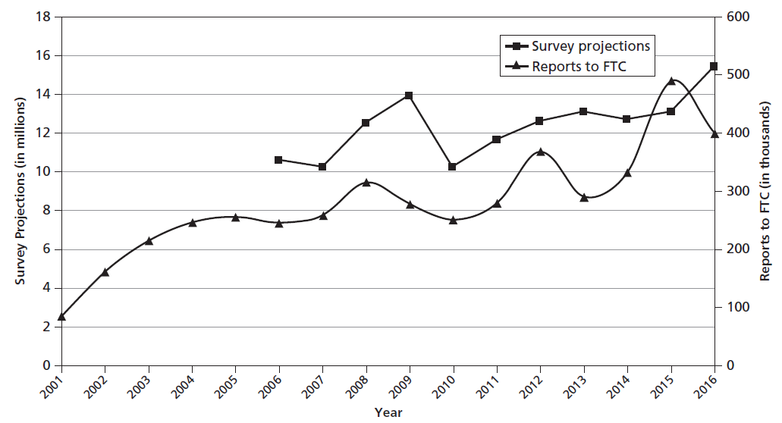
Figure 5.1 Trends in Identity Theft, United States, 2001–2016

Slide 18
How Many Identity Thefts Were Victim- Facilitated? (2 of 4)
Losses and Suffering
  Burden of proof falls to the victim.
  Threatens those who need security clearance for work
  Businesses sustain most of the losses.
  In 2016, individuals spent $16 billion repairing credit worthiness.
Factors affecting risk include:
  Internet usage
    Women, those aged 25–65, biracial, high-income level
  Geographic location
    Michigan and Florida

Slide 19
How Many Identity Thefts Were Victim- Facilitated? (3 of 4)
Thieves use a variety of methods:
  Stealing wallets, laptops, mail (even dumpster diving)
  Shoulder surfers
  Phishing and pharming
  Skimmers
  Caller ID phone spoofing

Slide 20
How Many Identity Thefts Were Victim- Facilitated? (4 of 4)
Victim blamers argue
  Carelessness (opening attachments, failure to shred documents, etc.)
  Failure to following preventative measures in Box 5.3
Victim defenders argue
  Prevention measures are impractical or unreasonable
  Even cybersmart people are victimized
System blamers argue
  There are huge data breeches that affect the majority of the public

Slide 21
Discussion Question 1
Television shows like Friends, and movies like Identity Thief and Catch Me If You Can have focused on stories of identity theft. Critics argue that identity theft is often glamorized or minimalized. Do you agree with that assessment or do you think the media embraces the full range of issues attached to this crime?

Slide 22
How Many Burglaries Were Victim- Facilitated? (1 of 2)
Residential burglaries are facilitated by open windows and unlocked doors.
Those most likely to be burglarized:
  Younger people
  Households with six or more people
  Blacks or Hispanics
  Lower-income households
Box 5.4 lists burglary prevention tips.

Slide 23
How Many Burglaries Were Victim- Facilitated? (2 of 2)
Security systems may not account for drop in burglaries.
  Other violent crimes fell during the same time period
  May be changes in American society
Victim defenders argue
  Most burglaries are forcible entries
System defenders argue
  Black market for stolen goods provides money-making opportunities for burglars

Slide 24
How Many Vehicle Thefts Were Victim-Facilitated?
Box 5.5 offers expert prevention tips.
Victim blamers argue
  Negligence
  Crimes of opportunity
  Unlocked cars (20%) and running cars (33%)
Victim defenders argue
  Professional thieves are a bigger problem than joyriders
  Only 1 out of 8 cars are key-facilitated
System defenders argue
  Secondary markets make thefts appealing

Slide 25
Discussion Question 2
In January of 2018, more than 80 cars were found in chop shop in Tampa, Florida. Do you think might affect future car thefts in that area? Will it have any affect in other areas?

Slide 26
Victim precipitation and provocation

Slide 27
Victim Precipitation and Provocation
Provocation is a stronger condemnation than precipitation.
Most victim-precipitated murders involve male victims and alcohol.
Charges of subintentional death often are leveled at repeat victims.
Some victims die because of street culture norms.
Deaths classified as justifiable homicide have no provocative victims, only dead offenders.
  Police brutality? Suicide by cop?

Slide 28
How Many Violent Crimes Were Precipitated or Provoked? (1 of 2)
National Commission on the Causes and Prevention of Violence
Alcohol consumption
  Selective-disinhibition perspective
  Outlet attractor perspective
Escalation via character contest

Slide 29
How Many Violent Crimes Were Precipitated or Provoked? (2 of 2)
Typical robberies (when transacted through instrumental coercion) proceed through five stages:
  Planning
  Establishing co-presence
  Developing co-orientation
  Transferring valuables
  Exiting
Box 5.6 details robbery prevention suggestions.

Slide 30
Transcending victim blaming and victim defending: system defending

Slide 31
Blaming the System for Violent and Property Crimes
Homicide
  Media’s glorification of violence
  Historically a means of conflict resolution
Robbery
  Gulf between the well-off and the poor
  Consumer-oriented society
Burglary
  Fencing incentivizes thievery

Slide 32
Blaming the System for the Problem of Identity Theft
Numerous data breaches expose personal data to thieves regardless of customer efforts.
Much personal information is readily available on the Internet.
Current laws are inadequate.
Companies are not held accountable for breaches or their impact.

Slide 33
The importance of Determining responsibility in the criminal justice process

Slide 34
Theorizing about Risk Factors: Figuring Out Why Certain Groups Suffer More Often than Others
Wrong place, wrong time
Theoretical explanations
  Start as hypotheses that answer questions beginning with “Why…?”
  Make empirical generalizations
  Ask “What accounts for this?”

Slide 35
Applying Deterrence Theory to Victims
Classical school of thought
  Free will or rational choice
Deterrence theory
  Offenders do not always learn the intended lessons in jail.
  Suffering may not deter the general public from committing crime.

Slide 36
Why Various Groups Experience Differential Risks: Routine Activities
Victimologists create theories using building blocks
  Attractiveness
  Situational factors
  Proximity
  Vulnerability
Routine activities theory stresses three variables
  Existence of motivated criminals
  Availability of suitable targets
  Presence/absence of capable guardians

Slide 37
Why Various Groups Experience Differential Risks: Specific Lifestyles
Daily activities govern the social ecology of victimization.
One’s lifestyle can account for differences in susceptibility to violence and theft.
Lifestyle theory stresses the importance of exposure to high-risk persons, at high-risk locations, and during time periods of high risk.
Engaging in deviant lifestyles greatly heightens risks.

Slide 38
Some Victims Were Criminals: The Equivalent Group Explanation
Equivalent group explanation
  Offenders choose victims from their own circles
Subculture of violence theory
  Fighting is often the first resort for some offenders and victims.
Blame-the-victim bias
  Implies that some victims’ suffering is less deserving of compassion, support, and respectful treatment

Slide 39
Discussion Question 3
In October of 2018, Mafia boss Sylvester Zottola was shot and killed as he waiting in line at a McDonald’s drive-thru lane in The Bronx. He was a chronic victim of violence. Police believe the hit was mob-related. How do the equivalent group and subculture of violence theories apply here? Do you think many people suffer from blame-the-victim bias under these kinds of circumstances?

Slide 40
What’s the Difference between Crime Prevention and Victimization Prevention?
Crime prevention relies on proactive strategies.
Crime control relies on reactive measures.
Victimization prevention involves tips, warnings, and advice.
  Risk-reduction activities
    Avoidance strategies
    Risk-management tactics
    Situational crime prevention
    Crime prevention through environmental design
    Crime resistance

Slide 41
Reducing Risks: How Safe is Safe Enough?
In general, it is safer to stay home, travel in pairs, avoid public places, avoid strangers, and keep one’s guard up.
A cost–benefit analysis determines when the odds pose an acceptable risk.
Victimologists must study prevention tips to determine if they work as intended.

Slide 42
Ambivalence and Risk Taking
American culture both embraces and abhors risk taking.
These attributes are mirrored in contradictory responses to victimization.

